Slide 1
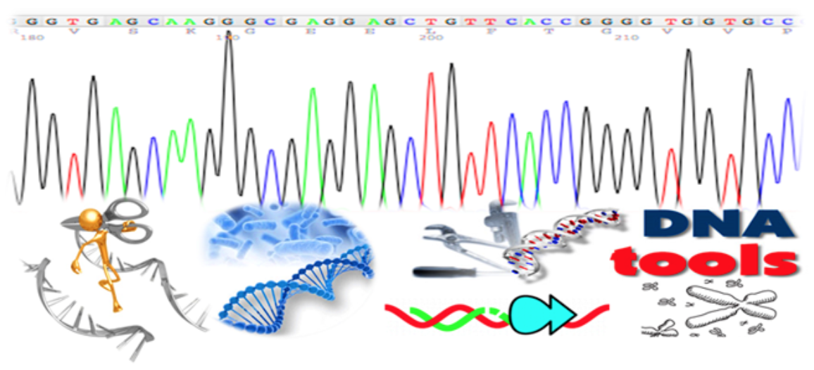
Biotechnology
Dr. Keller
Chapter 20
Mr. Anderson’s molecular biology: https://www.youtube.com/watch?v=yYIZgS-L5Sc
Mr. Anderson’s DNA fingerprinting: https://www.youtube.com/watch?v=DbR9xMXuK7c

Slide 2
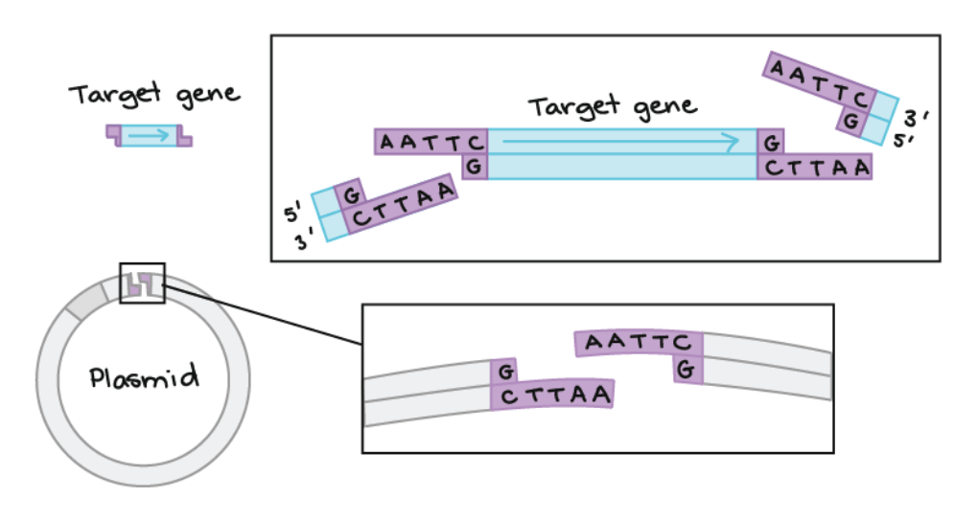
The DNA Toolbox
Restriction Enzymes (molecular scissors)
Complementary Base Pairing and DNA ligase (glue)
Gel Electrophoresis (separate pieces of DNA)
Polymerase Chain Reaction (PCR – make many copies of a piece DNA)
DNA Sequencing (give up the sequence of base pairs)
Notes:
Restriction Enzymes- isolated from bacteria. Cut DNA at specific sequences → usually give ”sticky” ends
Glue- hydrogen bonding between complementary base pairs (DNA ligase glues the DNA backbone together)
Gel Electrophoresis- separates and measures DNA fragments based on their size
PCR- makes millions of identical copies of a specific DNA fragment (needs primers, Taq polymerase (from hot springs), and all nucleotides (ATCG)
Sequencing- ability to “read” each nucleotide in DNA (uses dideoxynucleotides)
Bacterial plasmid: circular piece of DNA that bacteria will replicate for us
Bacterial transformation: pokes holes in bacteria so DNA can enter bacteria
DNA Cloning: makes many identical copies of a piece of DNA

Slide 3
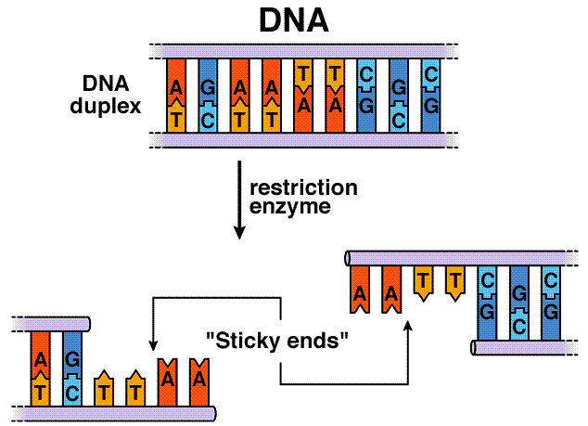
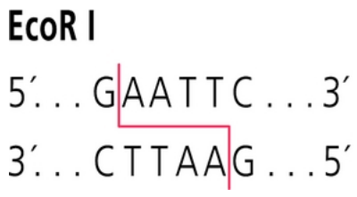
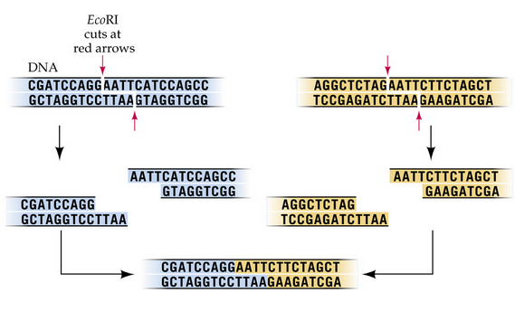
Restriction Enzymes “cut” DNA
Restriction Enzymes cut DNA as specific sequences called restriction sites often leaving single stranded overhanging “sticky ends”
5’
3’
3’
5’
5’
https://www.youtube.com/watch?v=8rXizmLjegI
5’
Two different pieces of DNA cut with the same enzyme can come together
H-bonds & DNA ligase
Notes:
DRAW 5’ and 3’ OVERHANGS ON BOARD
Restriction enzymes are isolated from bacteria and evolved in bacteria to protect against viral DNA infection (these restriction enzymes called endonucleases in bacteria) cleave DNA that has been injected in by bacteriophages (viruses that infect bacteria)
There are over 3000 known restriction enzymes that each recognize and cut different specific DNA sequence

Slide 4
Practice with Restriction Enzymes
Write the complementary base pairs to this single stranded DNA sequence. Also, identify which end is 5’ and which is 3’ on both strands.
Digest (separately) this DNA with all of the restriction enzymes provided below (shown both strands). Describe whether they have sticky or blunt ends.
-SacI: GAGCT^C
-EcoRI: G^AATTC
-KpnI: GGTAC^C
-EcoRV: GAT^ATC
CGGATATCGGTACCGAGCTCGAATTCGTAAT
Notes:
5’- CGGATATCGGTACCGAGCTCGAATTCGTAAT -3’
3’- GCCTATAGCCATGGCTCGAGCTTAAGCATTA -5’

Slide 5
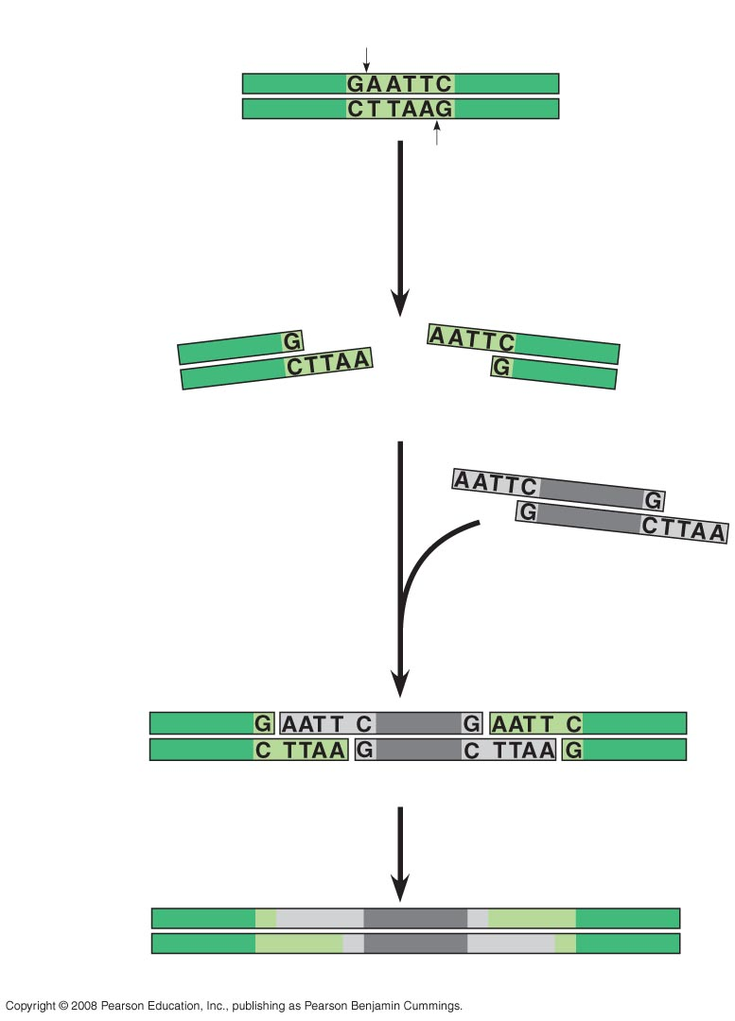
Cut DNA with restriction enzymes and glue DNA pieces together with DNA ligase
Restriction site
DNA
5′
3′
3′
5′
1
Restriction enzyme cuts sugar-phosphate backbones.
Recombinant DNA: combining DNA from two different sources into the same DNA molecule.
ex: DNA sequence of your choice, from your organism of choice put into a bacterial plasmid
Sticky end
2
DNA fragment added from another source
cut by same enzyme. Base pairing occurs.
One possible combination
3
DNA ligase seals strands.
Recombinant DNA molecule
Notes:
Bacterial plasmids are often called cloning vectors because they “carry” the DNA of interest into a host cell which will then replicate the DNA for you.

Slide 6
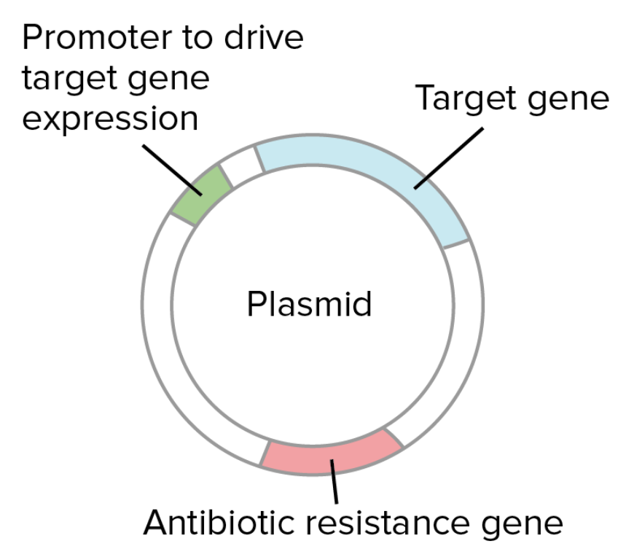
What is a bacterial plasmid?
A small, circular piece of dsDNA, distinct from the cell’s chromosomal DNA.
Elements of a plasmid:
Origin of replication (S-phase)
Promoter
Target gene
Antibiotic resistance (selection)
Notes:
Plasmids naturally exist in bacterial cells, and they also occur in some eukaryotes. Often, the genes carried in plasmids provide bacteria with genetic advantages, such as antibiotic resistance. When a bacterium divides, all of the plasmids contained within the cell are copied such that each daughter cell receives a copy of each plasmid. Bacteria can also transfer plasmids to one another through a process called conjugation.
Scientists have taken advantage of plasmids to use them as tools to clone, transfer, and manipulate genes. Researchers can insert DNA fragments or genes into a plasmid vector, creating a so-called recombinant plasmid. This plasmid can be introduced into a bacterium by way of the process called transformation. Then, because bacteria divide rapidly, they can be used as factories to copy DNA fragments in large quantities.

Slide 7
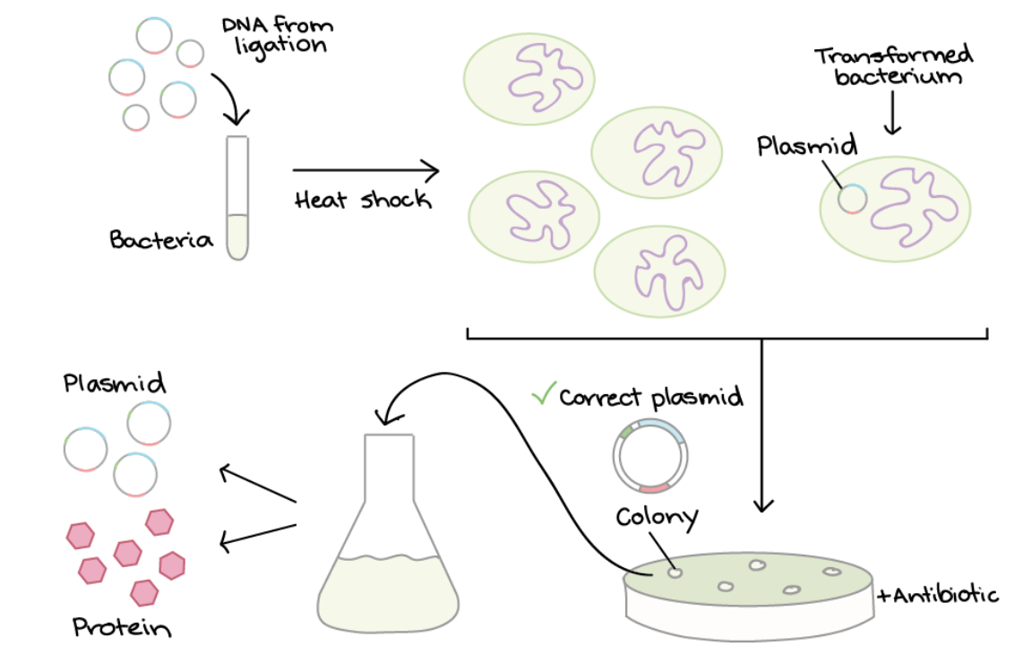
Bacterial Transformation and Selection
Target DNA on plasmid
a low % of bacteria pick up plasmid
a low % of bacteria pick up plasmid
mix with bacteria
heat shock
”transformed”
Pick a colony & grow it up
grow bacteria on plates +antibiotic
only bacteria with plasmid grow

Slide 8
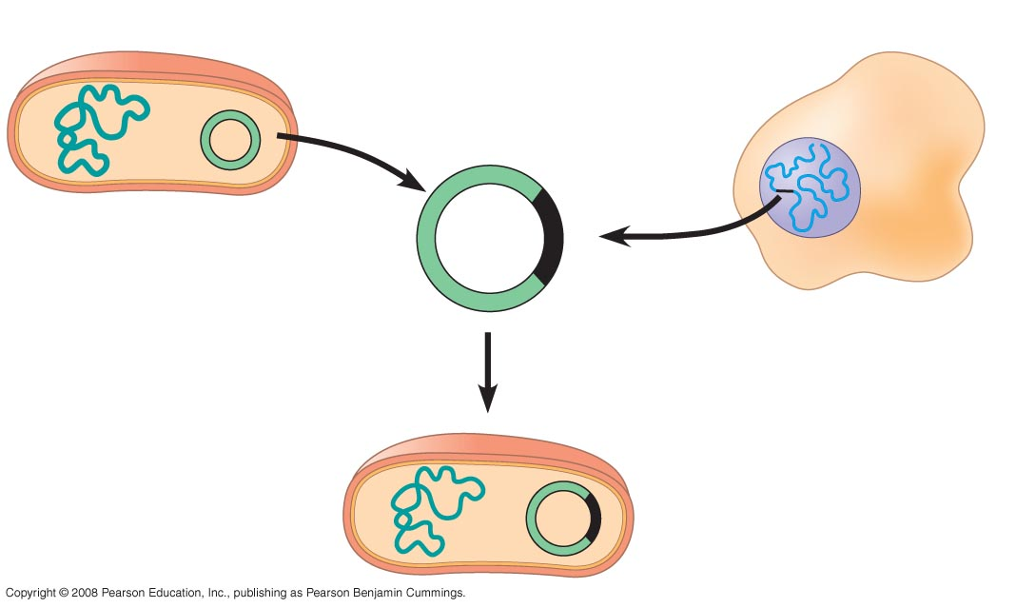
Gene Cloning
Cut “gene of interest” out of one organism & cut your plasmid
Put it into a plasmid
Transform bacteria (get plasmid inside)
Bacteria grows and copies plasmid (makes “clones” of your gene)
Bacterium
1. DNA isolation & cut
gene out with restriction
enzymes (gel to check)
Cell containing gene of interest
Gene of interest
Bacterial chromosome
Plasmid
Recombinant DNA (plasmid)
2. Glue gene into
plasmid with
DNA ligase
DNA from organism
of interest
Recombinant bacterium
3. Bacterial transformation
Notes:
Ex: we want to study the mutant cystic fibrosis protein. Isolate DNA from a person with CS…
Bacterial plasmid and gene of interest are both cut with the same restriction enzyme which allows them both to have a similar “cut” sequence which allows them to bind to each other.
Plasmids: In nature, plasmids often carry genes that may benefit the survival of the organism, for example antibiotic resistance. While the chromosomes are big and contain all the essential genetic information for living under normal conditions, plasmids usually are very small and contain only additional genes that may be useful to the organism under certain situations or particular conditions.

Slide 9
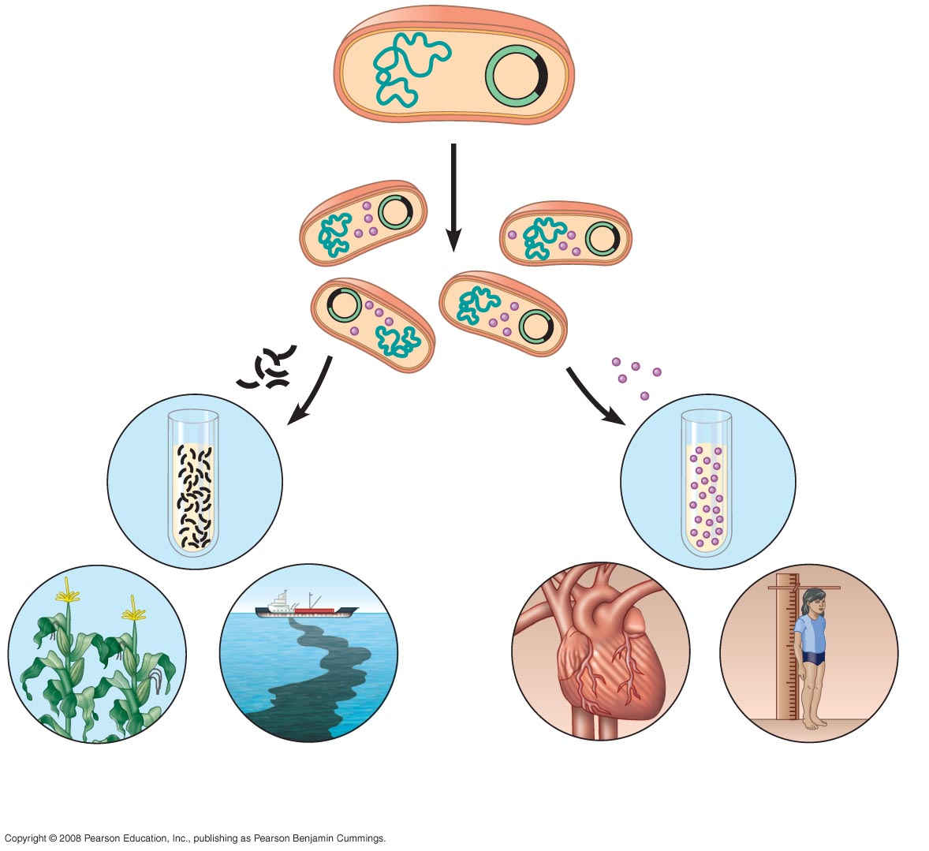
Recombinant bacterium
(plasmid with your
gene of interest)
4. Bacteria is selected with
antibiotic & grown in lab
to form a clones of
gene of interest
Gene of Interest
Protein expressed by gene of interest
Copies of gene
Protein harvested
Basic research on gene
Basic research on protein
5. Gene & protein basic
research with various applications
Gene for pest resistance inserted into plants
Gene used to alter bacteria for cleaning up toxic waste
Protein dissolves blood clots in heart attack therapy
Human growth hor- mone treats stunted growth
Notes:
Cloning is the process of producing similar populations of genetically identical individuals.
Cloning a gene is simply putting it into a bacterial plasmid and then having the bacteria make copies of it for us.

Slide 10
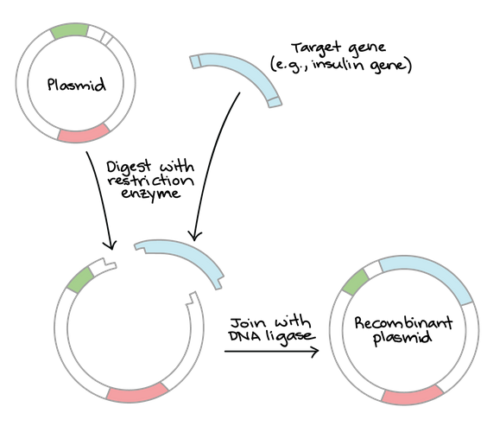
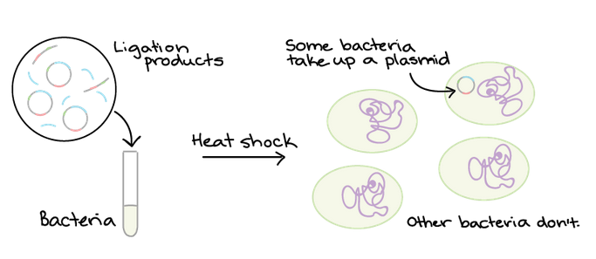
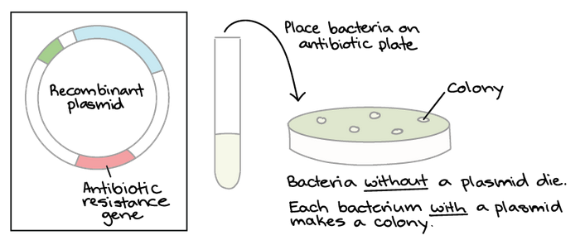
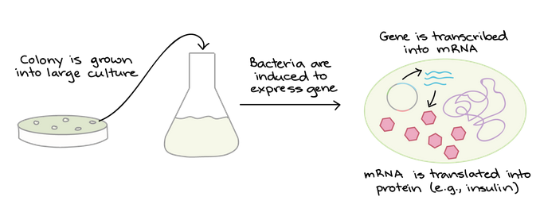
1. Create recombinant DNA
2. Transform plasmid into bacteria. Antibiotic selection identifies bacteria with plasmid
DNA Cloning in the lab
3. Grow up lots of plasmid-carrying bacteria and use them as “factories” to make the protein
Notes:
It's thought that the heat shock changes the fluidity of the membrane and/or causes pores (holes) to form, making it easier for the DNA to get across and enter the cell1^1​

Slide 11
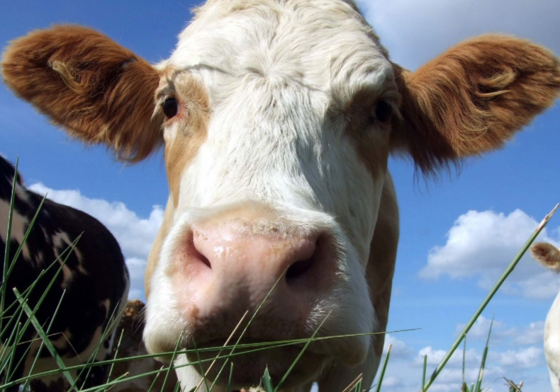
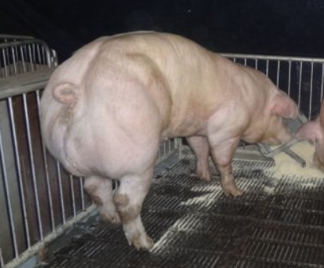
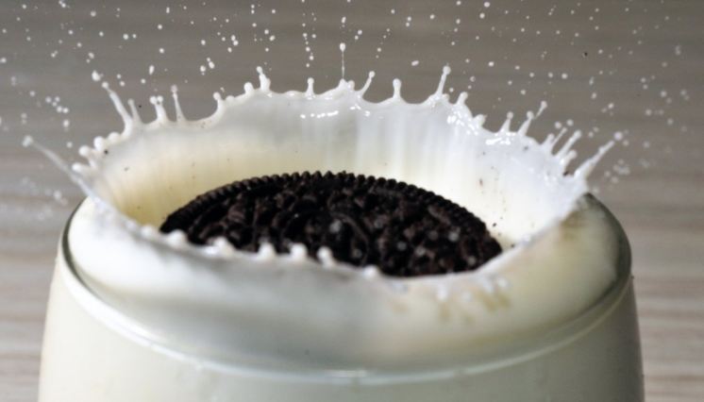
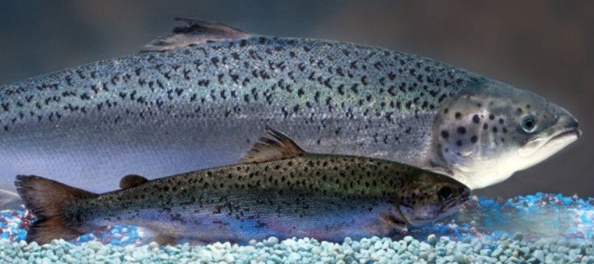
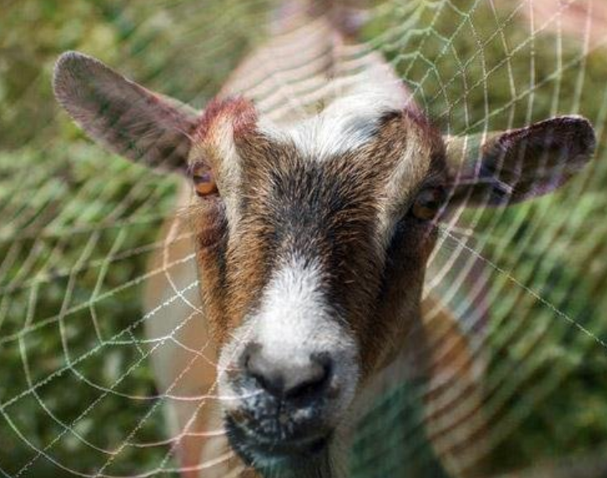
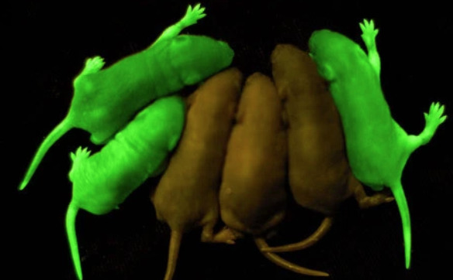
Transgenic Animals from Recombinant DNA
Notes:
Transgenic cows that fart less (produce 25% less methane)
Allergy-free milk from cows without beta-lactoglobulin (also more protein casein)
Goats engineered to produce a protein in spider silk in their milk
Super-muscly pigs to produce more muscle (which is what we mostly eat)
Introduced a gene that makes salmon grow much faster (currently in FDA review)
Glowing animals with the insertion of the jellyfish protein Green Fluorescent Protein (GFP)

Slide 12
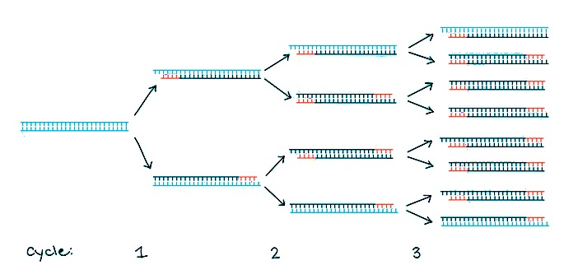
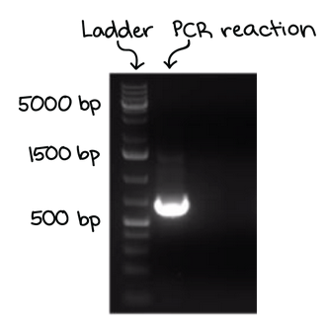
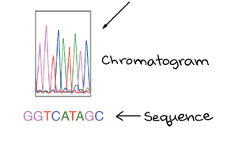
DNA Analysis Methods
Polymerase Chain Reaction (PCR)
Make millions of copies of a specific DNA region in vitro
Gel Electrophoresis
Technique used to separate DNA fragments according to their size
DNA Sequencing
Determine the sequence of nucleotides (A, T, C, and Gs) in a piece of DNA
Notes:
In vitro- means in a test tube rather than in an organism

Slide 13
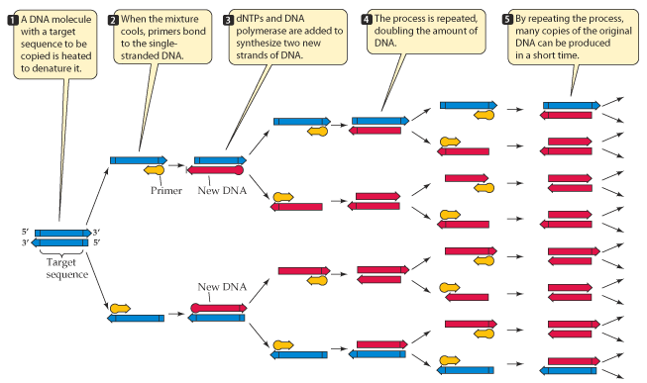
Polymerase Chain Reaction (PCR)
BioRad Song: https://www.youtube.com/watch?v=x5yPkxCLads
PCR Basics: https://www.youtube.com/watch?v=2KoLnIwoZKU
Notes:
Need Taq polymerase, primers, ATCGs, and way to change the temperature!!
1. Relies on a thermostable DNA polymerase (Taq polymerase) and requires DNA primers specifically for DNA region of interest
2. Reaction is repeatedly cycled through a series of temperature changes → making many copies
3. PCR has many applications (DNA cloning, medical diagnostics, forensics)
In vitro- means in a test tube rather than in an organism

Slide 14
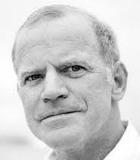
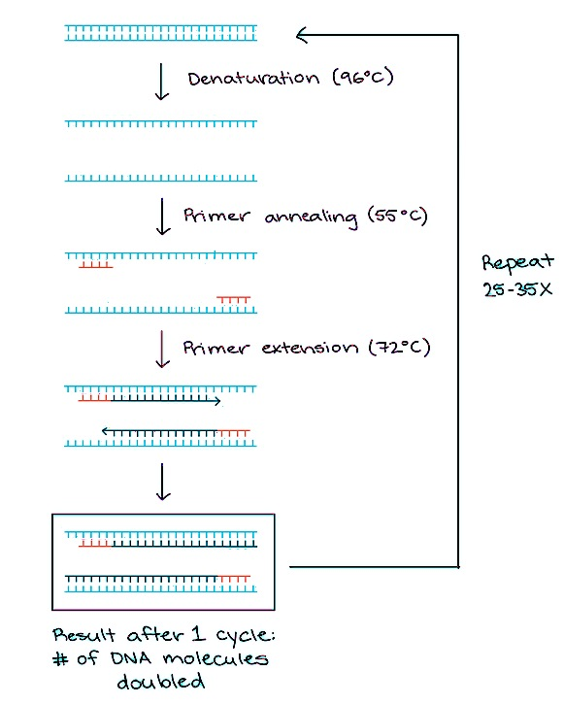
Polymerase Chain Reaction (PCR)
Kari Mullis
Three Repeating Steps:
Denaturation (96˚C) to separate DNA double helix
Annealing (~60˚C) of primers to complementary DNA
Extension (72˚C) of heat stable DNA polymerase
Notes:
Kari Mullis (1993 Nobel Prize) has denied climate change and AIDS and has said that his use of LSD spurred the discovery of PCR

Slide 15
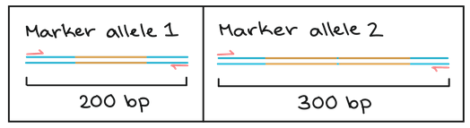
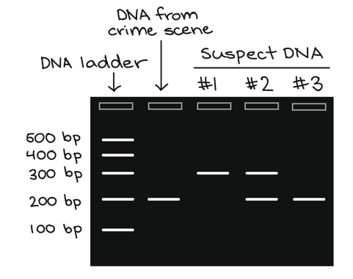
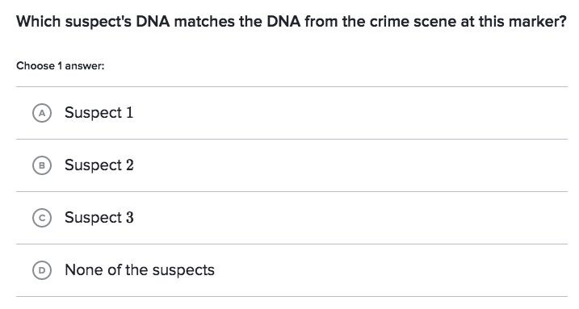
PCR in forensic science
A hair was left at the scene of a crime. You use a genetic marker to try and find the criminal from three suspects.
Why does suspect 2 have 2 bands?
Notes:
You received a DNA sample from a hair left at a crime scene, along with DNA samples from three possible suspects. You examine a particular genetic marker and see whether any of the 3 suspects match the hair DNA for this marker
Suspect 1- is homozygous for marker 2
Suspect 2- is heterozygous and therefore has both maker 1 and marker 2
Suspect 3- is homozygous for marker 1 (which is similar to the DNA found at the crime scene)

Slide 16
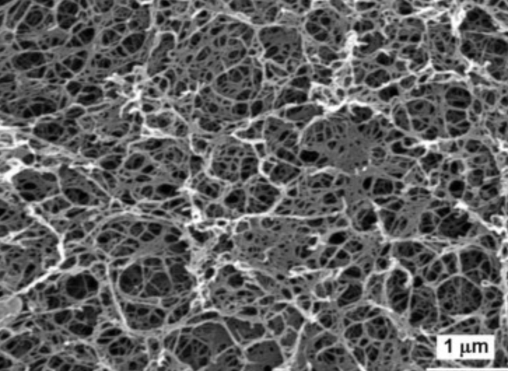
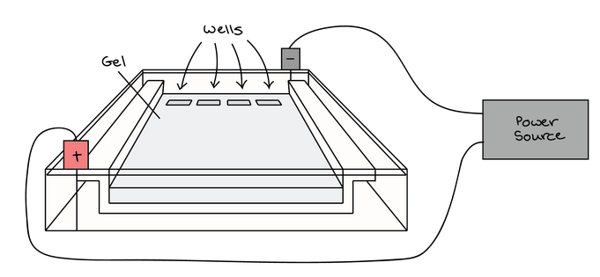
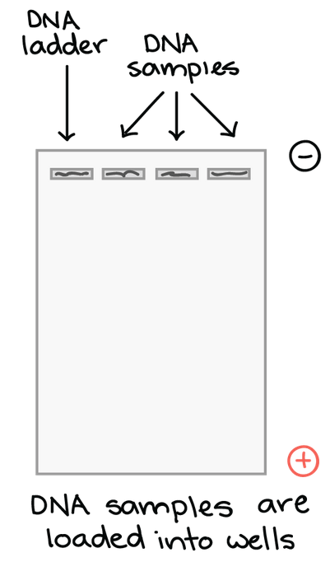
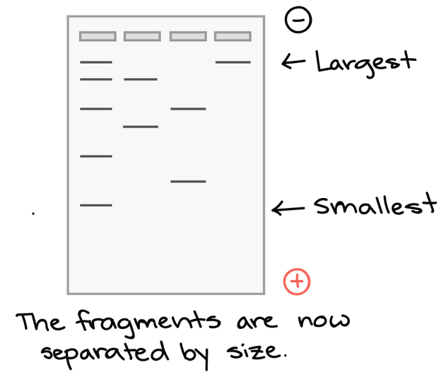
Gel Electrophoresis
DNA samples loaded into well at top of gel
Electrical current is applied
(-) DNA fragments move toward positive electrode
Large DNA is slower than small DNA
Gel stained with DNA-binding dye to analyze results

Slide 17
Gel Electrophoresis
Ladder: a standard reference that contains DNA fragments of known lengths.
Band: a well-defined “line” of DNA on a gel. Bands contains a large number of DNA fragments of the same size,
Compare bands in a sample to the DNA ladder to determine their approximate sizes.
What is the approximate size of the PRC reaction?
Notes:
~700 bp

Slide 18
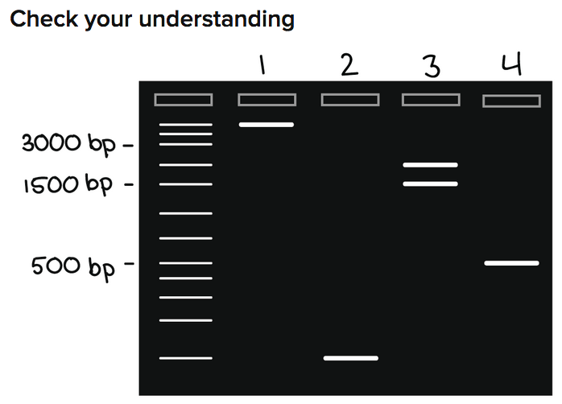
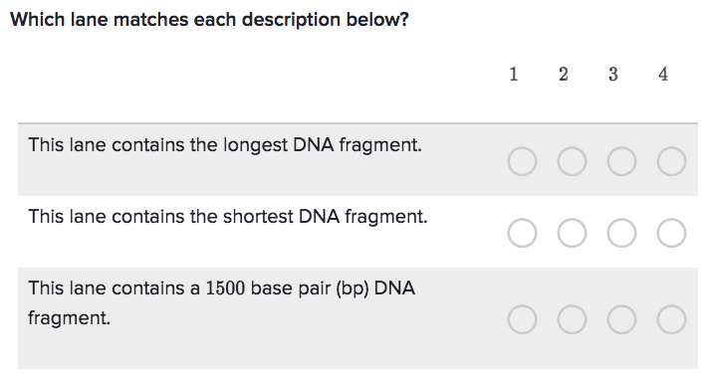
Notes:
1
2
3

Slide 19
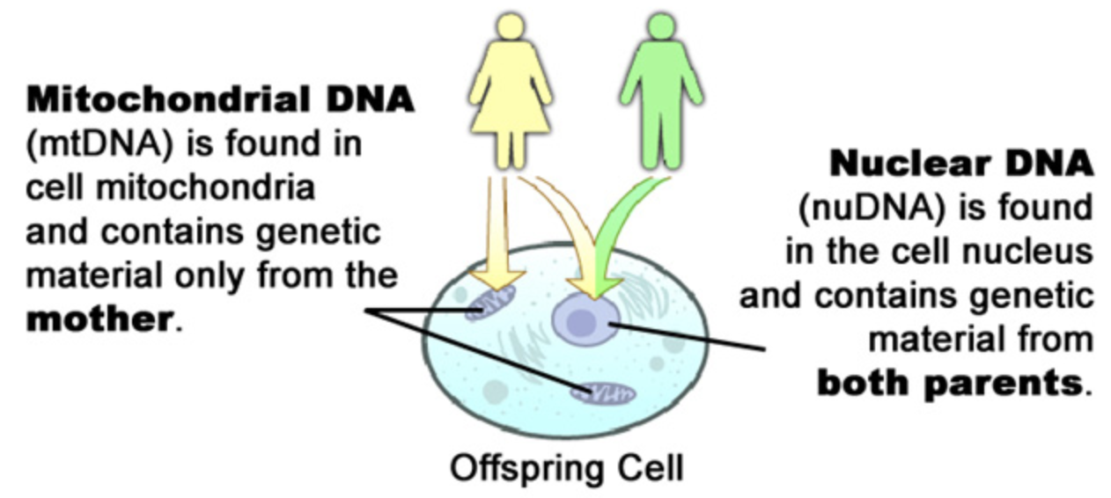
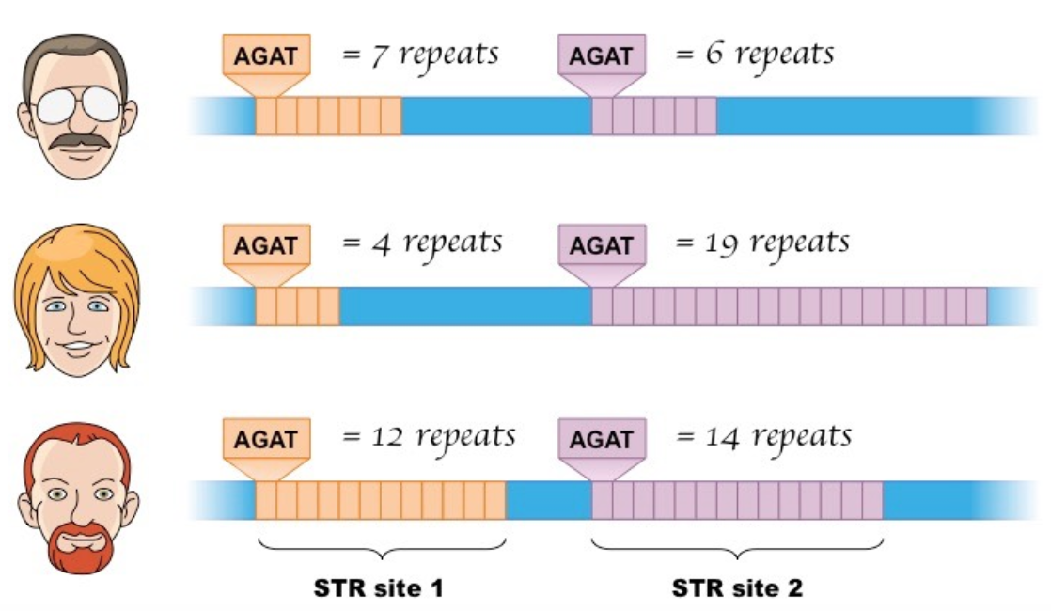
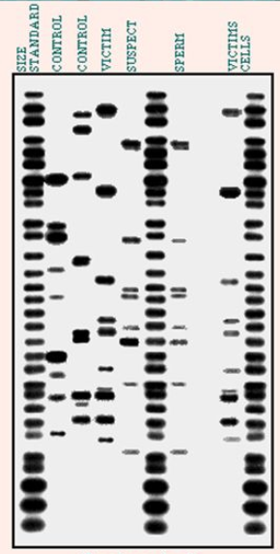
Forensics!!
Mitochondrial DNA
Length of repetitive DNA
DNA Fingerprinting:
shows variations in the length of restriction fragments produced by a given restriction enzyme.
Notes:
mtDNA used when biological evidence is degraded or in small quantities (only hairs, bones, teeth)
911 incident used mtDNA to identify bodies and get remains back to their families

Slide 20
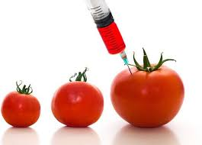
Genetically Modified Organisms (GMOs)
An organism whose genetic material has been altered in a way that does not occur naturally by mating and/or natural recombination
GMOs do the following:
Increase yield
Save on land
Better tasting fruit and veggies (less seeds, more juice, etc.)
Use less pesticides
Add nutritional value
Neil deGrasse Tyson on GMOs: https://www.youtube.com/watch?time_continue=5&v=1ecT2CaL7NA
In over 2,000 independently funded studies, no one has yet detected any allergy, harm, or risk to humans, animals, or the environment from commercialized GM crops.
Notes:
Golden Rice- Rice with beta-carotene (vitamin A) added
Bt Corn- Corn with a bacterial chemical added that is toxic to insects but not humans

Slide 21
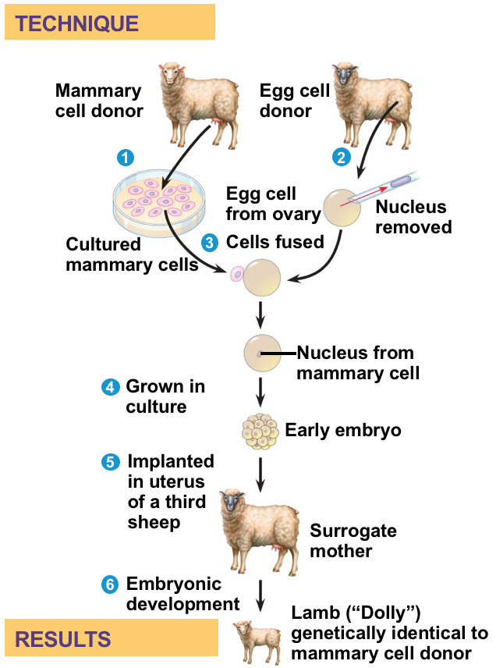
Whole Animal Cloning by nuclear transplantation
Clone your pet:
https://viagenpets.com/dog-cloning/
http://www.myfriendagain.com/
Notes:
Since 1997, cloning has been demonstrated in many mammals, including mice, cats, cows, horses, mules, pigs, and dogs. Problems often arise due to changes on the DNA (methylation, acetylation) which isn’t as easy to duplicate.
Dolly was euthanised because she had a progressive lung disease and severe arthritis. A Finn Dorset such as Dolly has a life expectancy of around 11 to 12 years, butDolly lived 6.5 years.
Cloning uses nucleus from preexisting somatic cell rather than a sperm cell

Slide 22
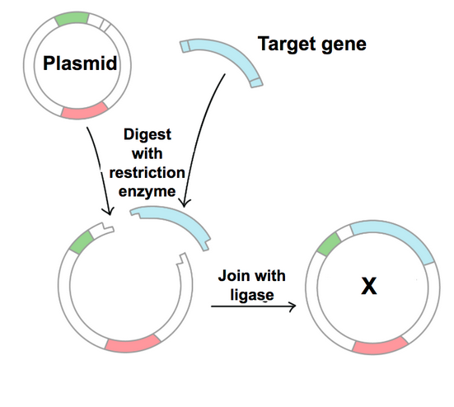
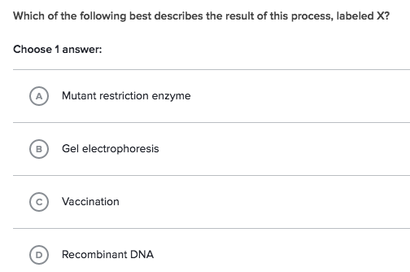
Practice Problems
Notes:
D

Slide 23
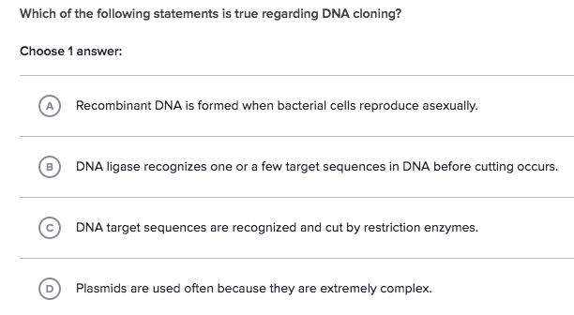
Practice Problems
Notes:
C

Slide 24
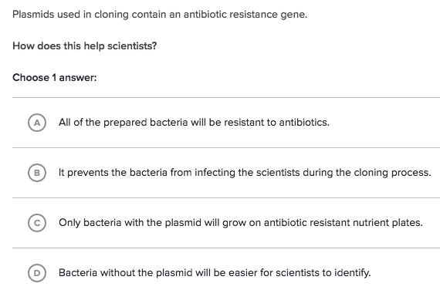
Practice Problems
Notes:
C

Slide 25
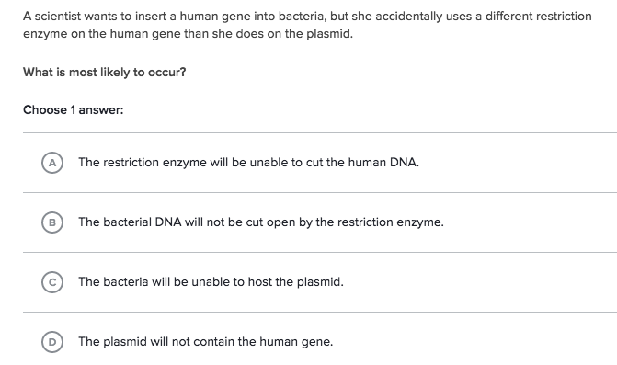
Practice Problems
Notes:
D

Slide 26
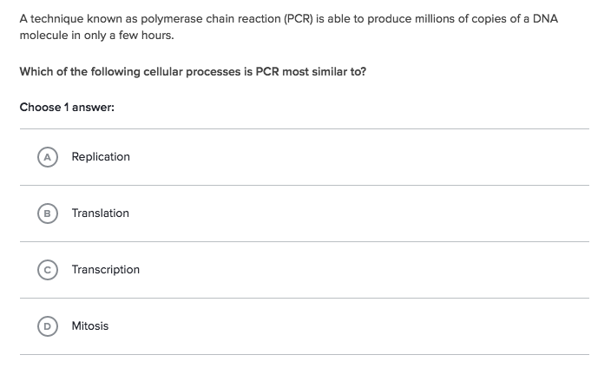
Practice Problems
Notes:
A

Slide 27
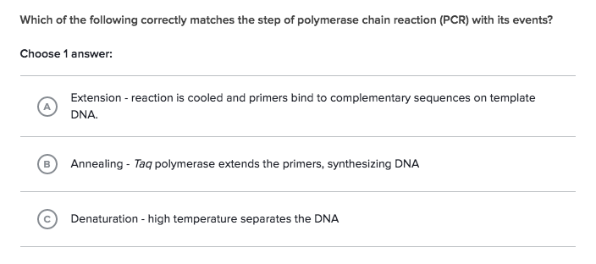
Practice Problems
Notes:
C

Slide 28
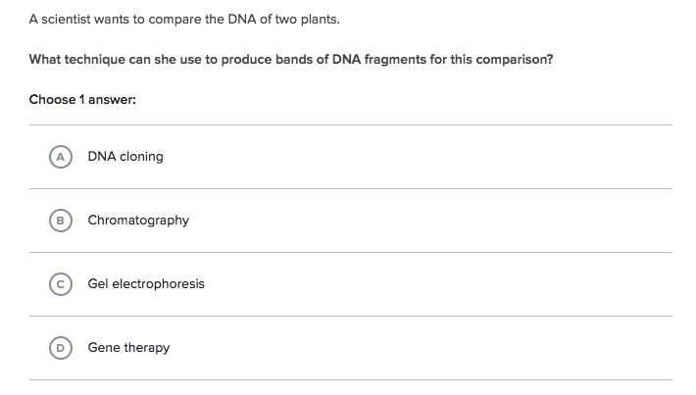
Practice Problems
Notes:
C

Slide 29
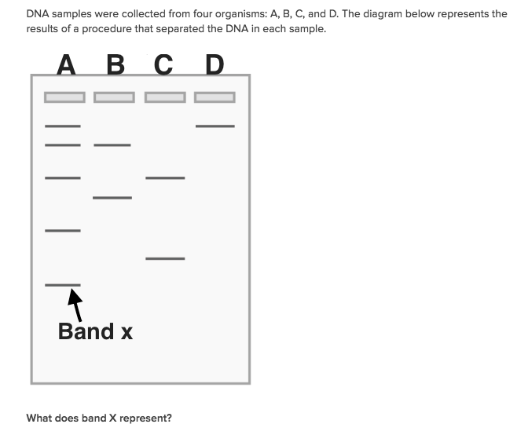
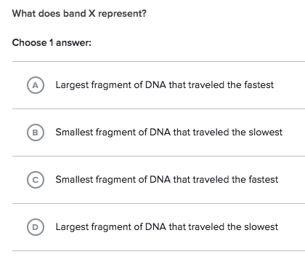
Practice Problems
Notes:
C

Slide 30


Practice Problems
Notes:
C

Slide 31

Practice Problems
Notes:
C

Slide 32
Extra slides with cool modern biotechnology!

Slide 33


RNA-Interference: silence gene expression
Silence (remove) your gene/protein of interest by interfering with the mRNA
control
RNAi-1
RNAi-2
What are these data showing you?
Protein 1
Protein 2
Quick RNAi Info: https://www.youtube.com/watch?v=J4b0oRdFeF4

Slide 34

CRISPR: DNA Editing
Cas9 endonuclease is brought to specific site and cuts DNA. Upon repair- you can provide new DNA to replace the cut out region.
Quick CRISPR Info: https://www.youtube.com/watch?v=ZImVkl8QTW8
Notes:
CRISPR- Clustered Regularly Interspaced Short Palindromic Repeats

